Slide 1

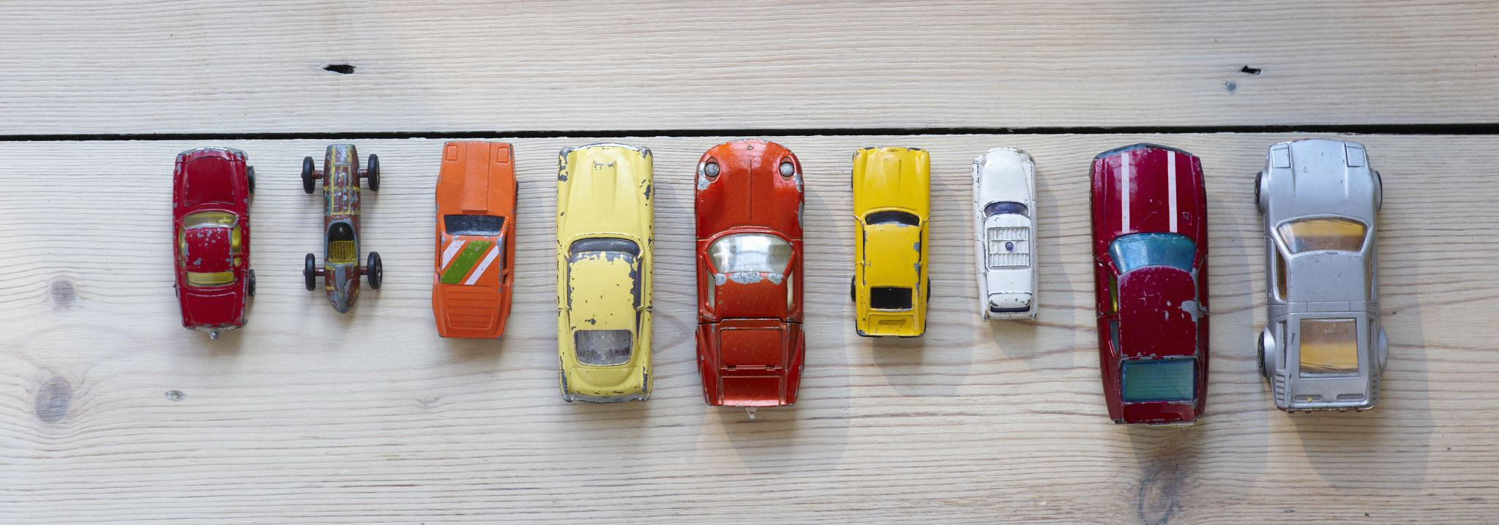
PREDICTING USED CAR PRICE
BY: PERPETUAL OKAFOR
Notes:
Hi everyone, my name is Perpetual and my final project was based on predicting used car price using a regression machine learning model

Slide 2
ABOUT ME
I have a Bachelors degree in Geology from Dalhousie university
Currently working as a research assistant
Pursued data science because I was interested in the field and I needed a career change
Notes:
A little bit about me. I have a bachelors degree in geology from Dalhousie university. Currently working as a reaserch assistant and I felt it was time for a career change and I looked into data science and found it really interesting and it is also a growing industry as well and decided to go for it.

Slide 3
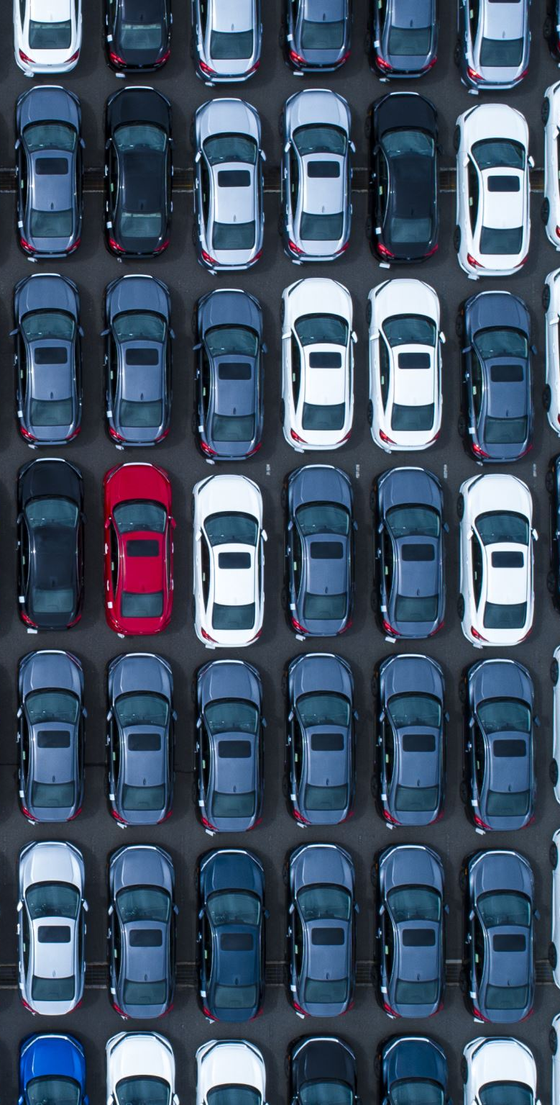
Why I chose this project
There as always been a need for people to sell or buy a used car
This prediction system can help both the buyer and seller.
Notes:
I chose to do this project because the used car sales market is a booming industry. there has always been a need for an individual to want to sell or buy a used car. Not everyone can afford to buy a brand new car and will result to buying a used car instead. And also people sell their used for variety of reasons like for example they need the money to cover some other expenses, or they want a different kind or car
This prediction system can help people to decide whether the price they are paying or quoting for a used car is good.

Slide 4
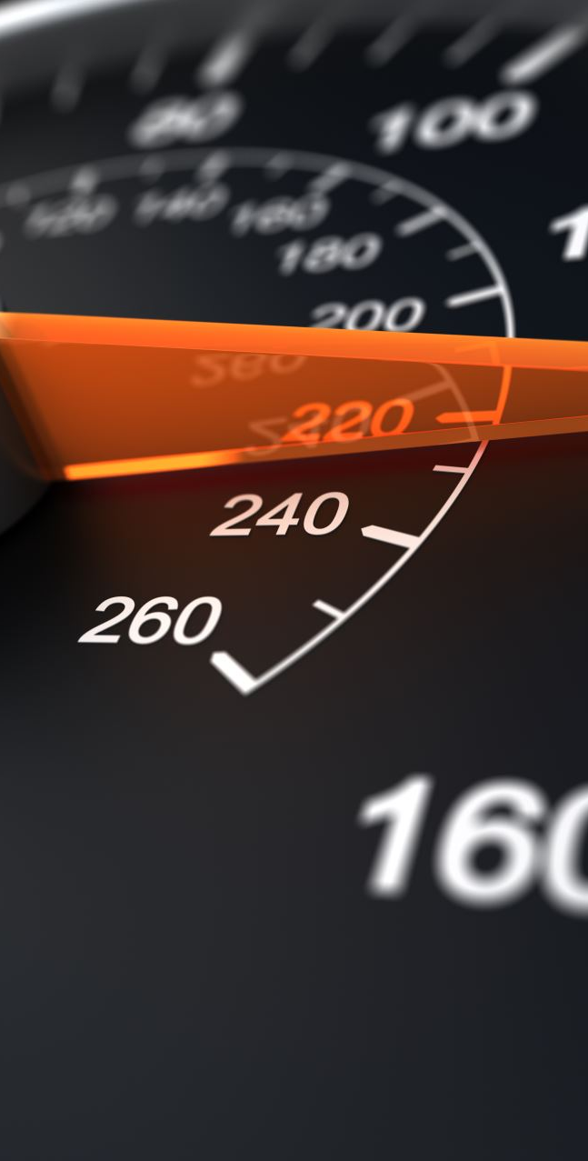
Data exploration
The dataset was gotten from Kaggle
Included features like car model, manufacturer, mileage, fuel type etc.
The data was cleaned by replacing missing values and dropping irrelevant columns.
Performed exploratory analysis on the data
Notes:
The dataset was gotten from Kaggle. It consisted of about 500,000 rows of data
It included features like car model etc
The data was cleaned by replacing missing values, checking for duplicates, dropping irrevalent columns and also removing outliers.
I did some exploratory analysis on the data as well.

Slide 5
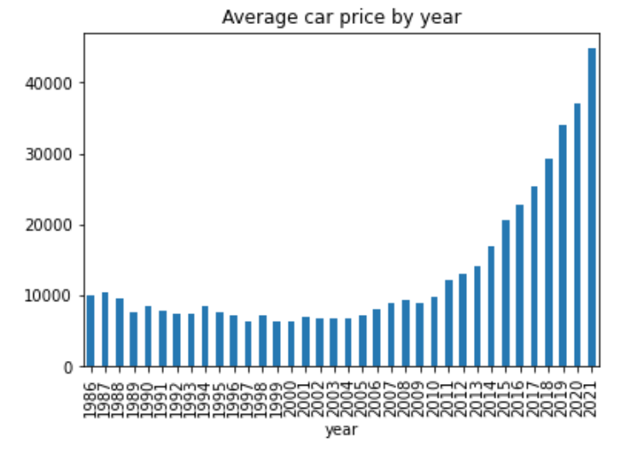
Data visualization
From this visualization, we can see that current cars cost more than cars produced in the previous years.
Notes:
The first feature I looked at against the price was the year of manufacture. We can see that current cars cost more than cars manufactured in the previous years

Slide 6
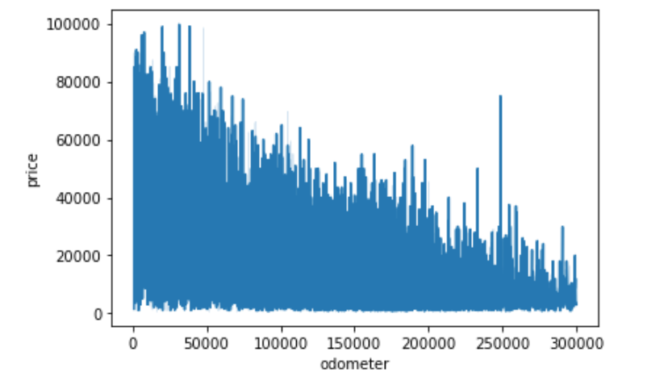
DATA VISUALIZATION
This plot shows that cars with less mileage have a higher price range compared to cars with higher mileage
Notes:
I also looked at the mileage against the car price. Cars with less mileage generally cost more than cars with higher mileage

Slide 7
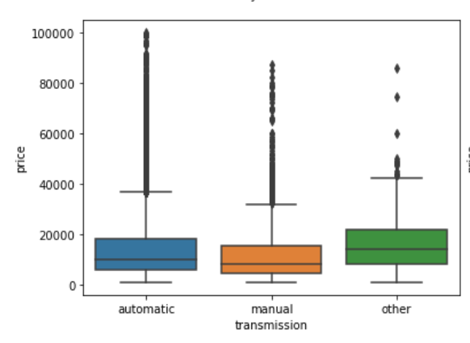
DATA VISUALIZATION
Automatic cars cost more then manual cars.
Other transmission types like electric cars
Notes:
When comparing the transmission types against the price, automatic cars has a higher price range compared to manual cars. The other type of transmission like electric vehicles cost more than both automatic and manual cars

Slide 8
Building the Model
Random Forest regressor model was used to make predictions
It had an r2 score of 0.77
Transformed categorical data using one hot encoding
Notes:
I trained the dataset using different regression model and random forrest had the highest R2 score of 0.77 after applying hypertuned parameters.
I used One hot encoding to convert categorical data to numerical.

Slide 9
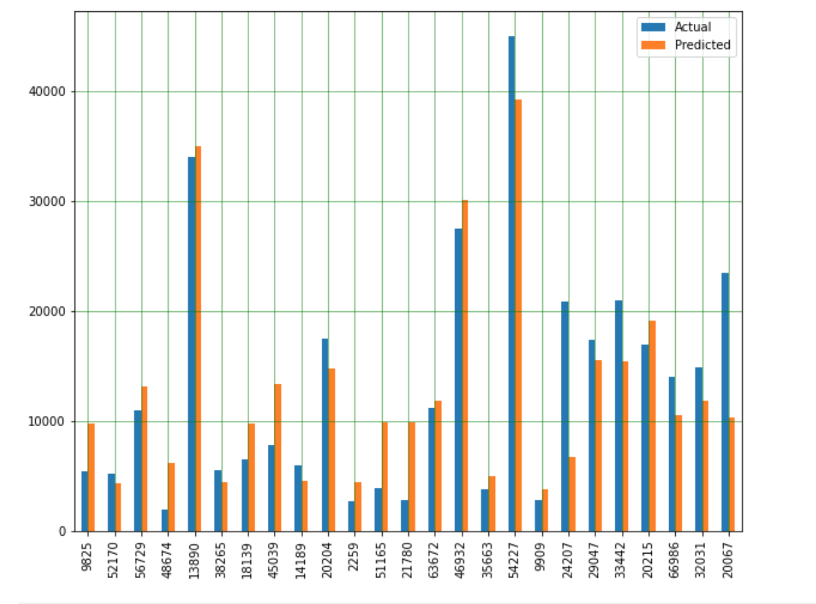
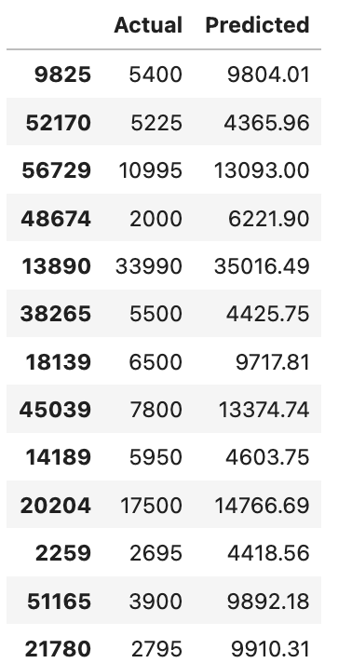
RESULT
Notes:
This is the result of the model showing some of the predicted values against the actual value. While the model accuracy could still be improved, the model performance is still acceptable.

Slide 10
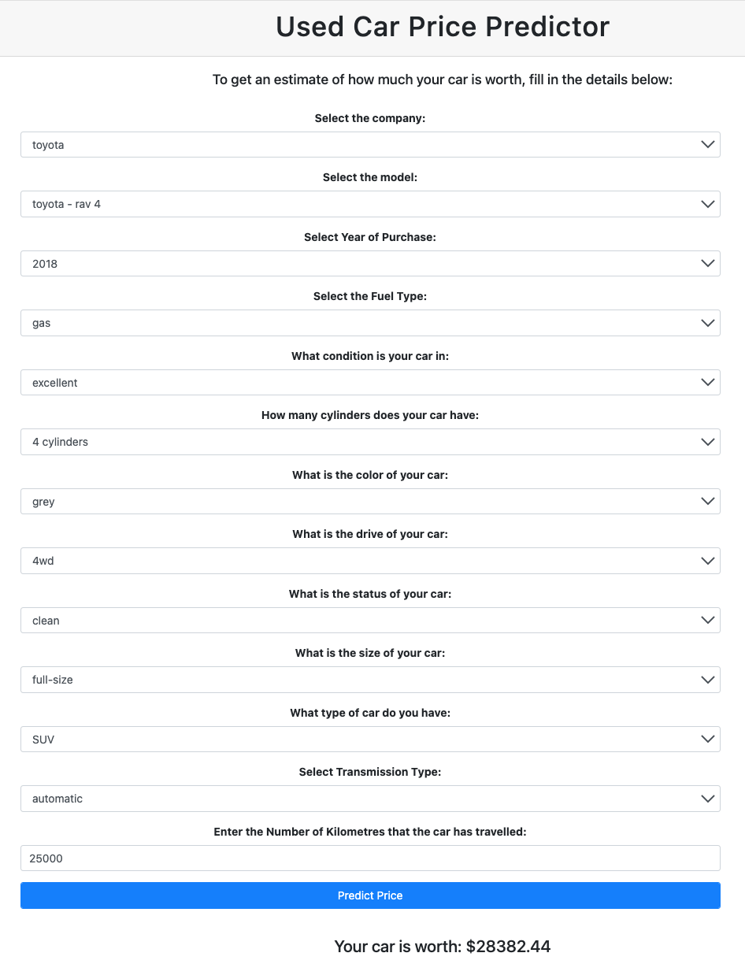
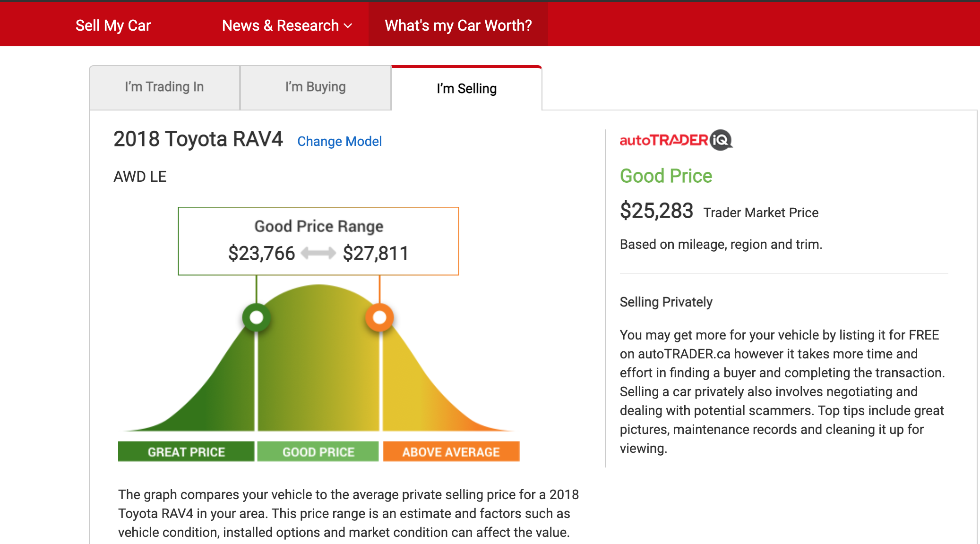
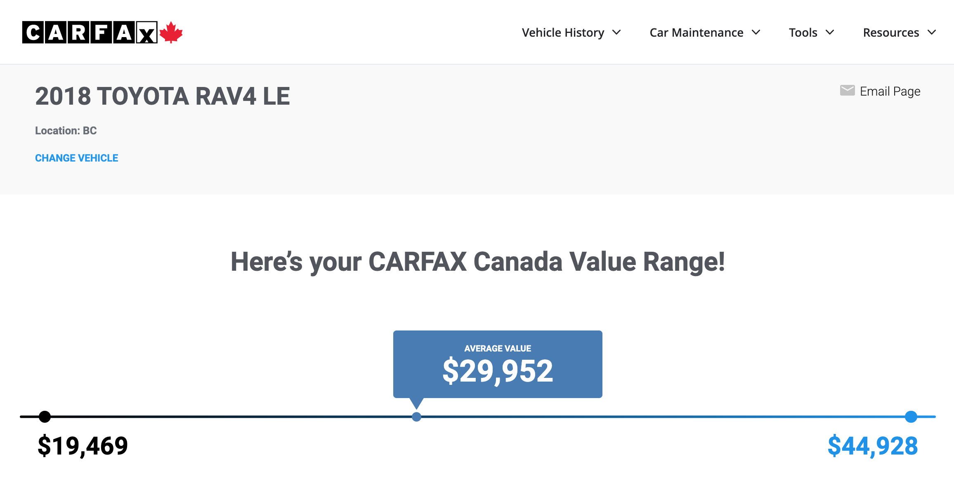
Comparing model with other car predicting websites
Notes:
I compared my model against other used car predicting website like auto trader and Carfax. Predicting the price of a 2018 Toyota rav4 with 25k kilometers, my model predicted a selling price of 28k , while autotrader gave a selling price of 25k and Carfax gave a price of 29k. All three prediction model gave an estimate that are close to each other. I would say this was a successful project for me. Thank you.

Slide 11

THANK YOU

